Slide 1


PRESENTS
SMART
EXTENSION
SYSTEM(SES)
FOR
ABUDHABI AGRICULTURE AND FOOD SAFETY AUTHORITY (ADAFSA)

Slide 2





Globally Accredited Software Consultation Partner
IT Strategy, Application Development, Maintenance and Testing Services, Information Management, Digital Marketing
WHY VERBAT
Nearly two decades of development experience to Global Corporates and Government
Verbat is a Digital Technology Services company with 20+ years of experience in delivering Internet and Mobile Solutions to Enterprises, through Agile Development and Application Management Methodologies.
Domain specialists in Banking, Retail, Logistics, Construction, Fashion, Manufacturing, Hospitality, Automotive, Government & Healthcare
Spearheaded by a team of Technology and Management Leaders

Slide 3

HIGH LEVEL OBJECTIVES
The SES will be the primary tool for the ADAFSA Agricultural Extension Engineers (AEE) to disseminate best agricultural practices and to record details of important information.
The SES will allow instant reporting on assessment and technical advices.
“
The project is focused on building a Digital solution to facilitate the recording, reporting, analysing, prioritizing and monitoring of the extension activities
“
Notes:
Project Outcomes (10,000 feet overview)
a. Enhance customer experience
b. Processes Automation
c. Provide ADAFSA internal users with one Product to manage day to-day business operations
d. Minimize the number of human interventions …. and in the process
e. Build a comprehensive database of farms and farmers
f. Provide ADAFSA management with Dashboards, and reports on the whole aspects of the
services.
High-level Objectives
1. Provide better technical advisory services during farm visits
2. Help farmers to adopt recommended practices and innovations
3. Evaluate and monitor programs and extension staff so that better management decisions can be made to increase farm production & sustainability
4. Provide extension staff with a unified vision that enables greater productivity in the farms while preserving natural resources and promoting sustainability of resources
5. Finally…the Assessment and measurement of agricultural sustainability index (44 key indicators)

Slide 4

PROJECT SCOPE
01
TO CREATE AGRICULTURAL PRODUCT
DATABASE TO MANAGE SES DATA
....................................................................
01
INTELLIGENT SYSTEM FOR CAPTURING DATA, MAINTAINING DATA INTEGRITY AND FOR PREVENTING DUPLICATION
.........................................................
02
RESPONSIVE WEB, MOBILE AND TABLET APPLICATION FOR MANAGING THE
EXTENSION ACTIVITIES
.............................................
03
INTUITIVE DASHBOARD, COMPREHENSIVE REPORTS AND WORKFLOW MANAGEMENT
...................................
04
Notes:
Project Scope
2. Capture farm visit records using mobile devices that are geo enabled
3. Mobile app with intelligent and intuitive workflows to capture data

Slide 5
02
OFFLINE FORMS SAVING AND ONLINE SYNC CAPABILITIES
...................................
05
GEO ENABLED SERVICES
.............................................
06
INTEGRATION WITH OTHER PARTNER SYSTEMS
.........................................................
07
WEB APP DEV USING ASP.NET, MS SQL &.
MOBILE DEV USING REACT NATIVE
....................................................................
08
Notes:
5. integration with Siebel to manage, farms, farm owners etc.
6. Ensure data security and integrity
7. Web based Reports and Analytics dashboard for management
8. Advice on technology and frameworks that enable scalability and meet diverse integration requirements

Slide 6
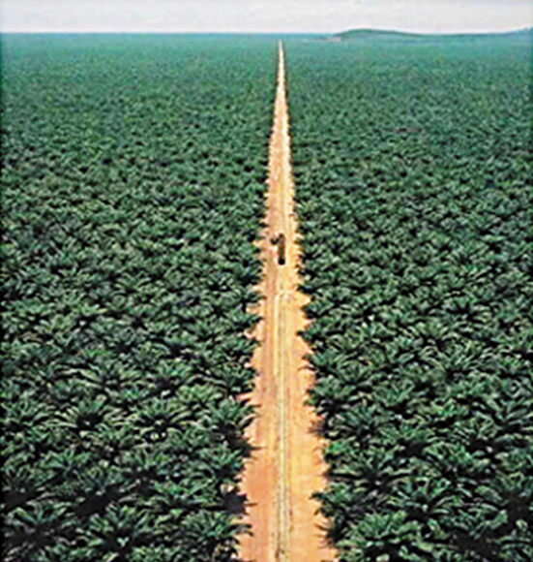
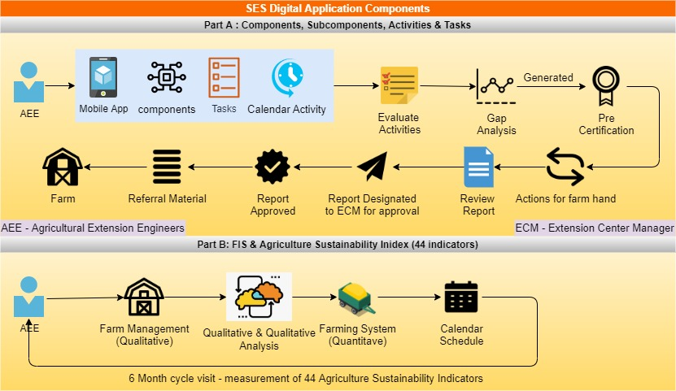
SMART EXTENSION SYSTEM
FUNCTIONAL REQUIREMENTS
Notes:
The Smart Extension System Application will be downloaded on tablets/mobile to be used by
the field extension staff during farm visits in their duty stations. The application will cover
two parts:

Slide 7
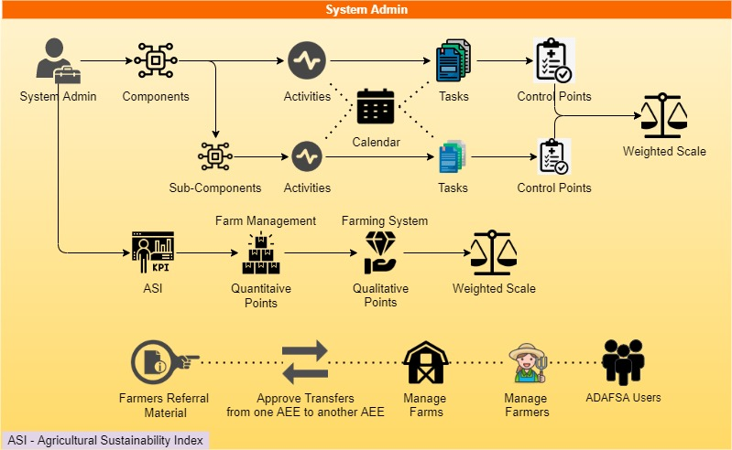
ADMIN USER
FUNCTIONAL REQUIREMENTS

Slide 8
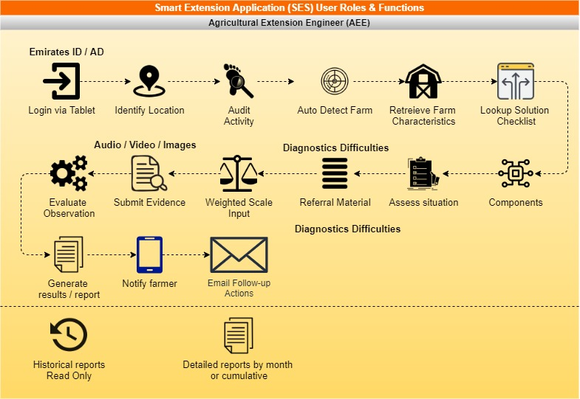
AGRICULTURAL EXTENSION ENGINEER (AEE)
FUNCTIONAL REQUIREMENTS

Slide 9
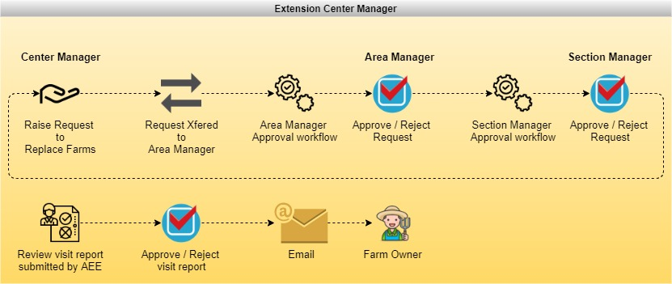
EXTENSION CENTER MANAGER
FUNCTIONAL REQUIREMENTS

Slide 10
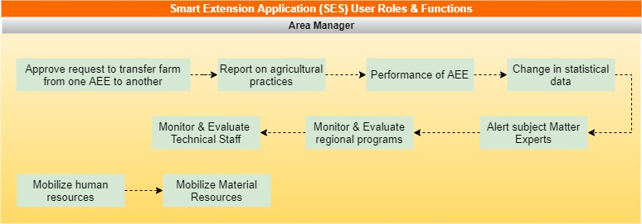
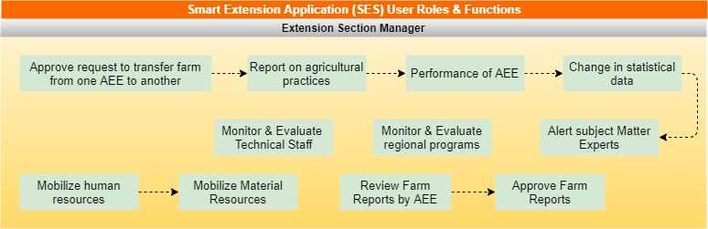
AREA MANAGER AND SECTION MANAGER
FUNCTIONAL REQUIREMENTS

Slide 11
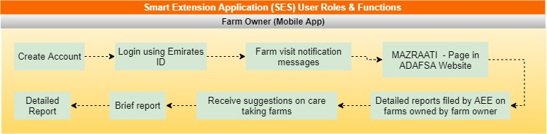
FARM OWNERS
FUNCTIONAL REQUIREMENTS

Slide 12
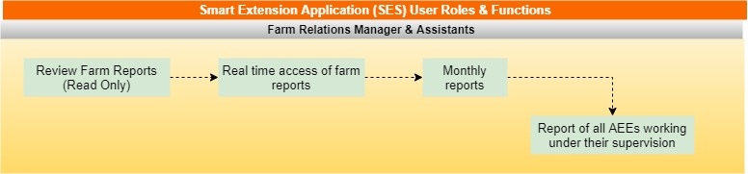
FARM RELATIONS MANAGER AND ASSISTANTS
FUNCTIONAL REQUIREMENTS

Slide 13
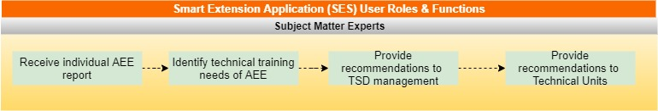
SUBJECT MATTER SPECILISTS
FUNCTIONAL REQUIREMENTS

Slide 14
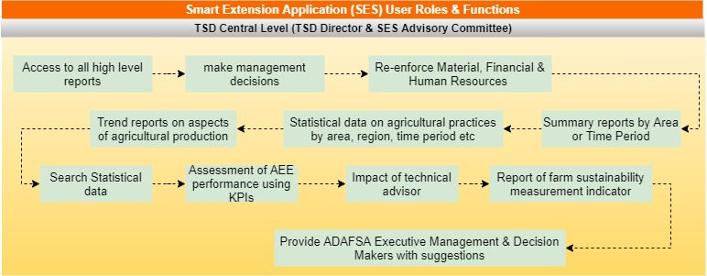
TSD CENTRAL LEVEL
FUNCTIONAL REQUIREMENTS

Slide 15

01
ENHANCED USER EXPERIENCE BY AUTOMATING PROCESSES AND BY REDUCING HUMAN INTERVENTIONS
01
ASSESSMENT OF TECHNICAL DATA, FARM INFORMATION SYSTEM (FIS) & AGRICULTURE SUSTAINABILITY INDEX (44 INDICATORS)
02
APPLICATION
FEATURES.
03
USER FRIENDLY DASHBOARDS, REPORTS AND WORKFLOWS
04
CONTINUOUS FEEDBACK AND PERFORMANCE MONITORING

Slide 16
02
05
DATA ANALYSIS USING SES OUTPUTS
06
IN APP NOTIFICATION AND MESSAGING FEATURES
07
DESIGN & DEVELOPMENT USING THE MOST MODERN PRACTICES.
08
MULTILINGUAL SYSTEM
ENGLISH & ARABIC

Slide 17
SIMILAR
PROJECTS

Slide 18
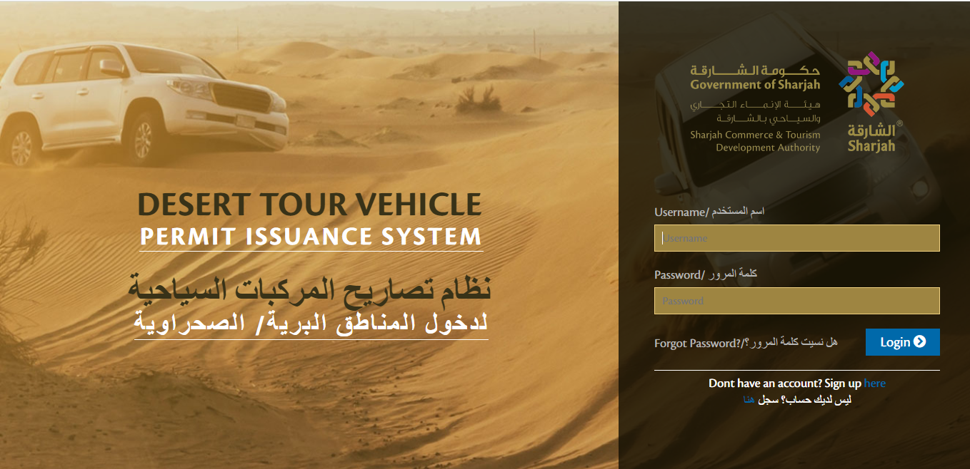
DESERT TOUR VEHICLE
PERMIT ISSUANCE SYSTEM
Login Page
Notes:
DESERT TOUR VEHICLE PERMIT ISSUANCE SYSTEM GOVERNMENT/TOURISM SECTOR
Separate modules for Tour Operator, Staff and Manager
Visually Engaging & User/Friendly Interface
Integration with Tasheel System for payment
SMS and Email notifications
Audit Trail, Reports

Slide 19
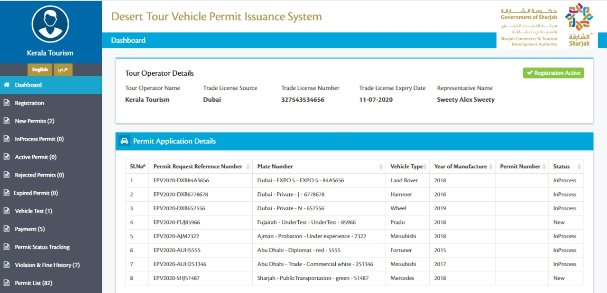
Tour Operator Dashboard

Slide 20
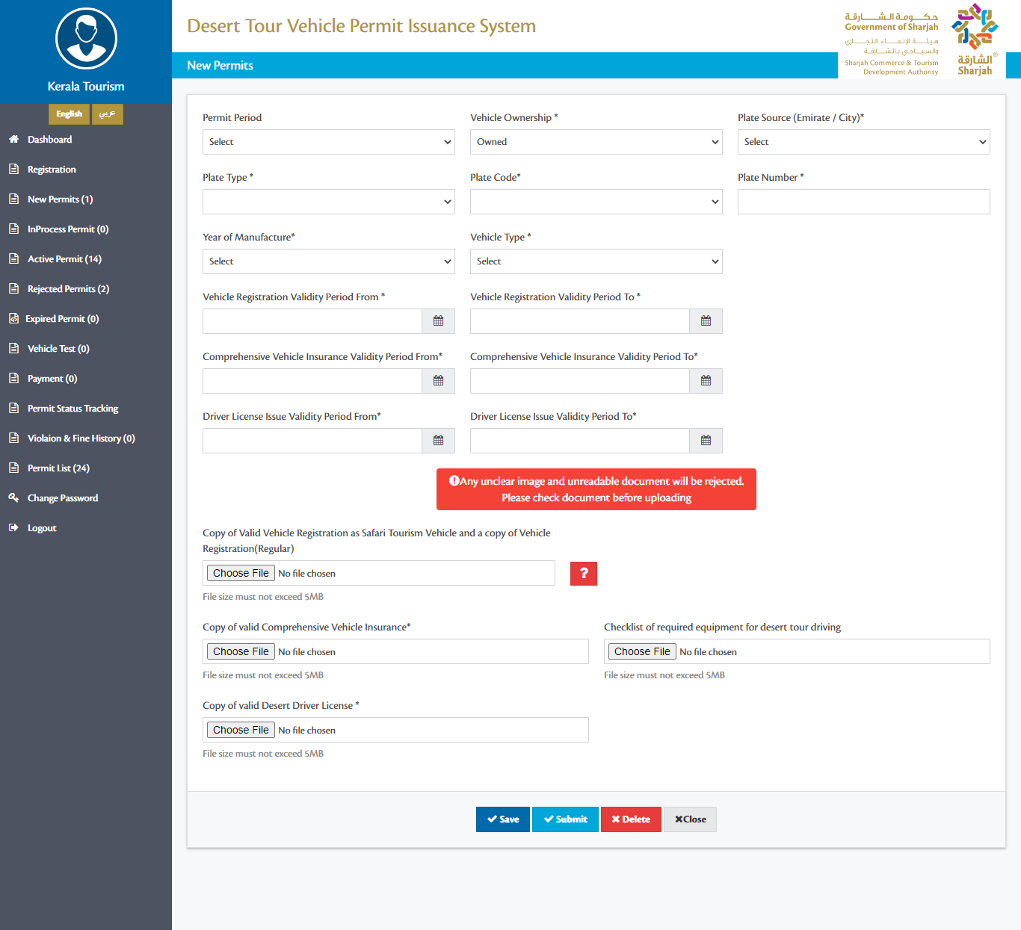
Request New Permit

Slide 21
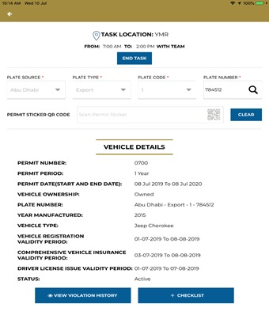
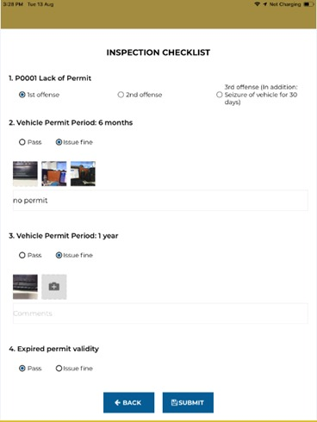
Inspection Module – Tablet Application

Slide 22
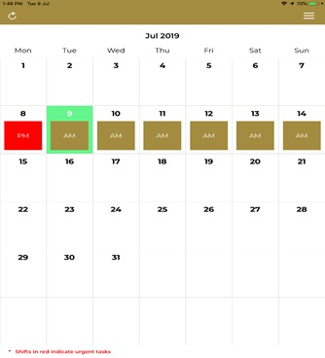
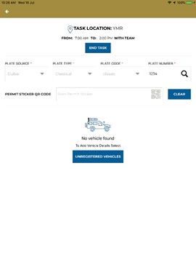
Inspection Module – Tablet Application

Slide 23
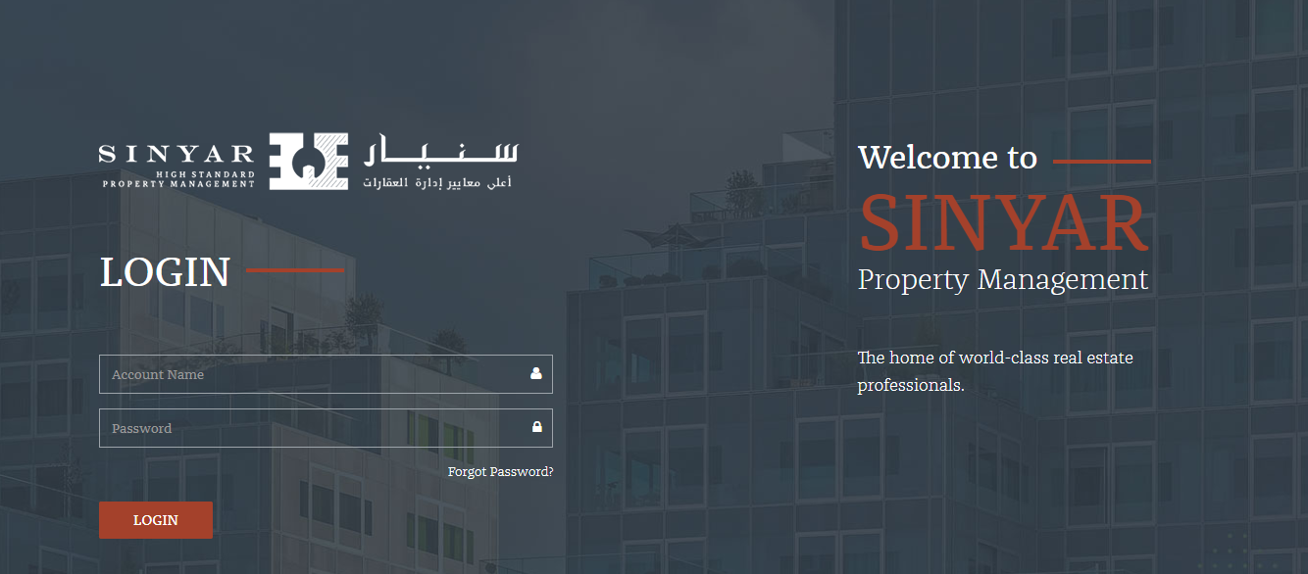
SURVEY
MANAGEMENT SYSTEM
Login Page
Notes:
SURVEY MANAGEMENT SYSTEM
REAL ESTATE SECTOR
Responsive Web Application
Vendor & Property Registration
Survey Creation & Assignment
Inspection of assigned surveys
Approval Workflows
Survey Reports

Slide 24
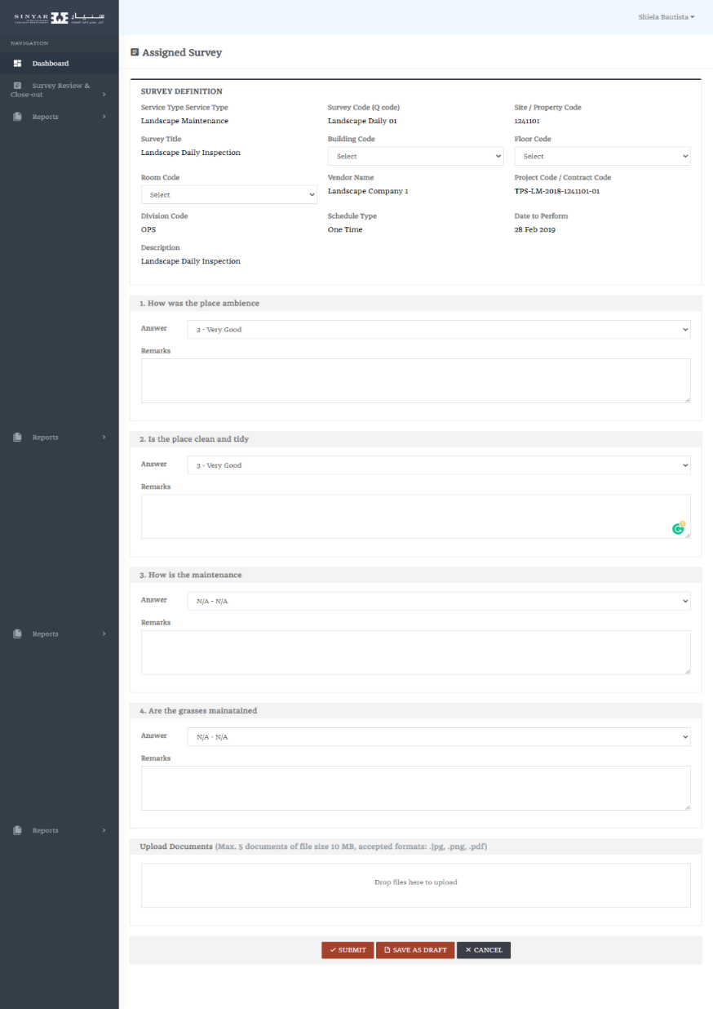
Assigned Survey

Slide 25
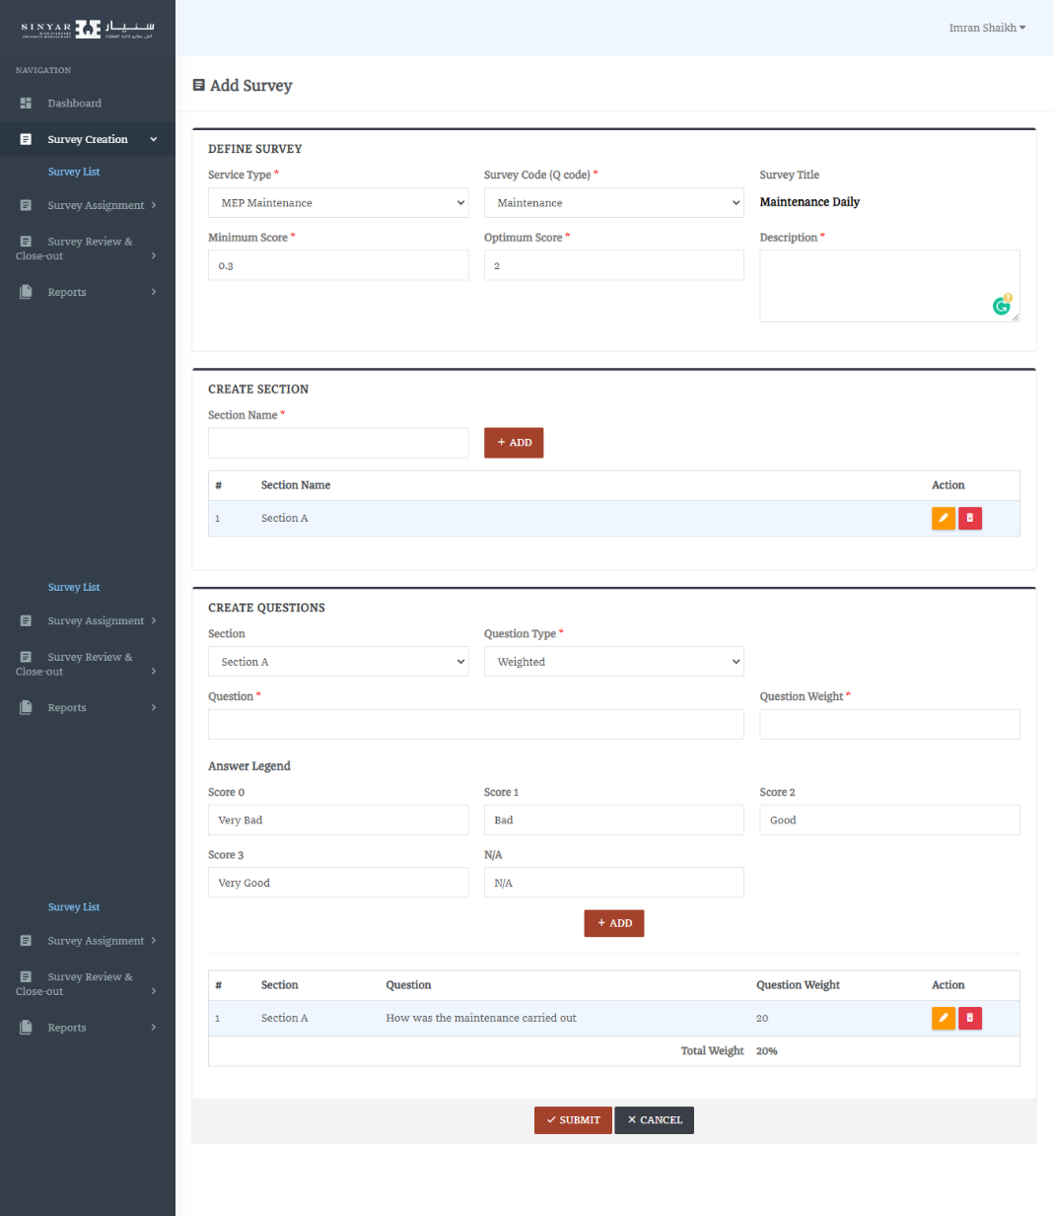
Add Survey

Slide 26
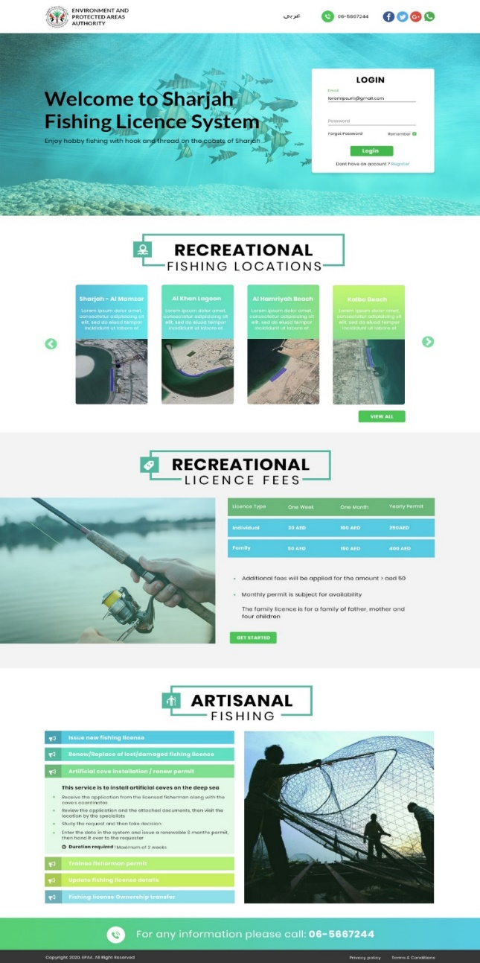
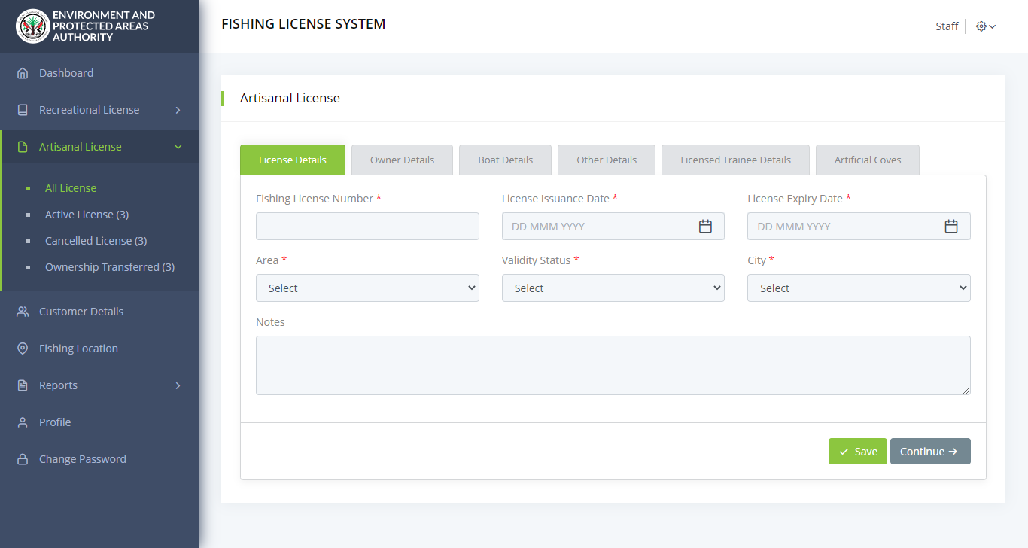
FISHING
LICENSE SYSTEM
EPAA Website Design
Create Artisanal License

Slide 27
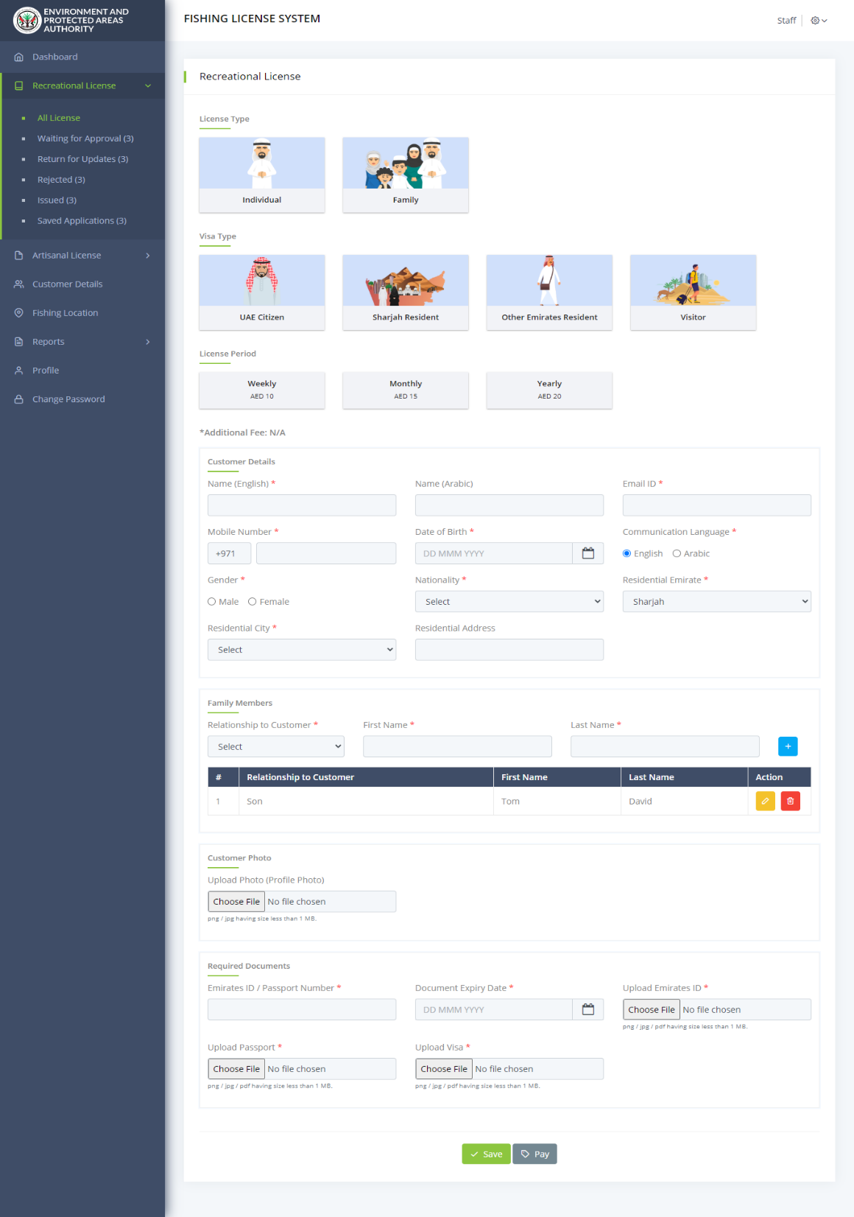
Create Recreational License

Slide 28
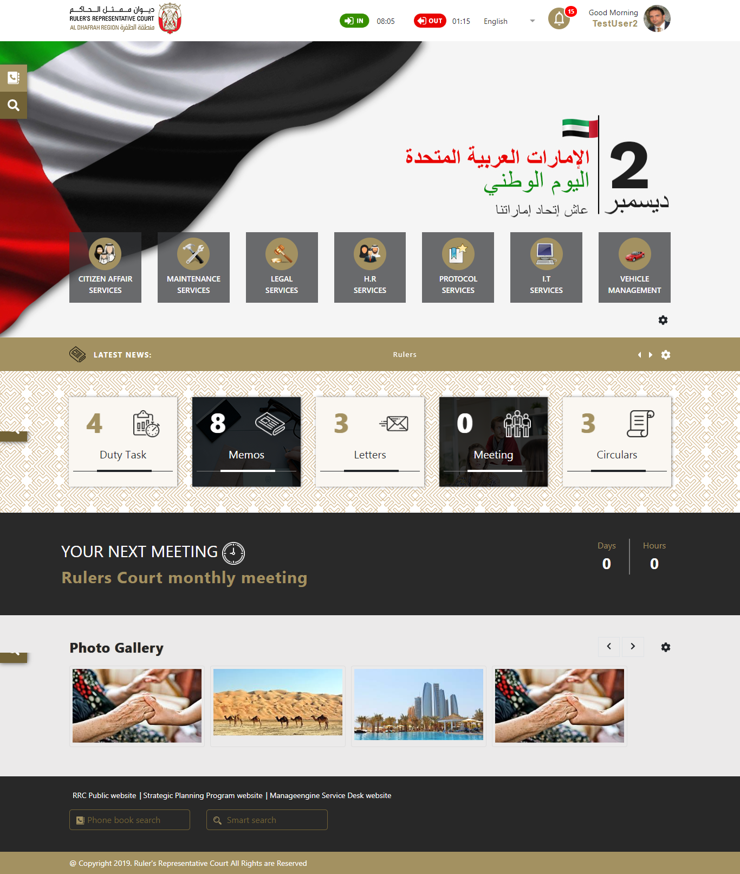
SMART COURT
MANAGEMENTSYSTEM
Home Page

Slide 29
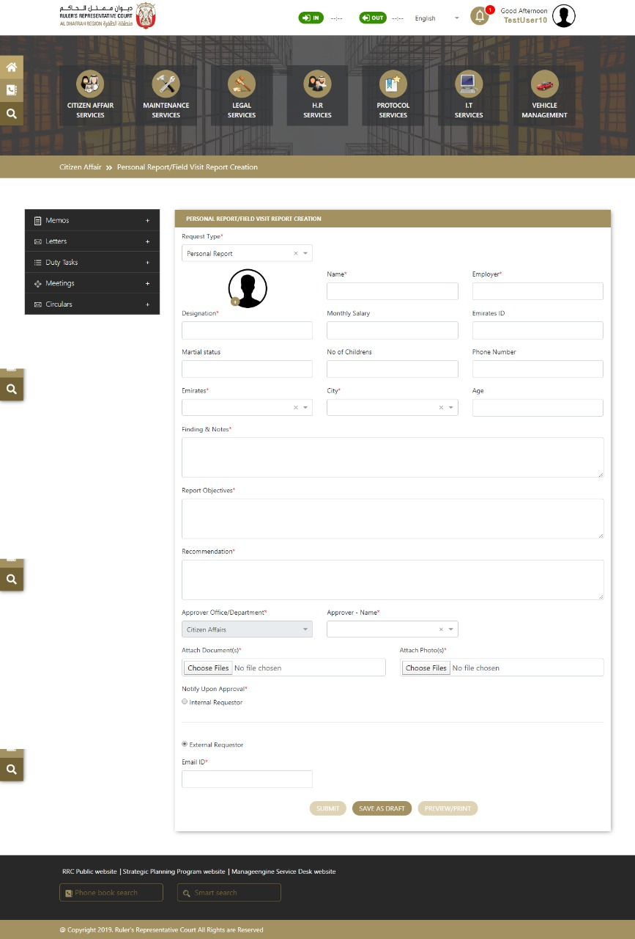
Citizen Affair - Personal Report

Slide 30
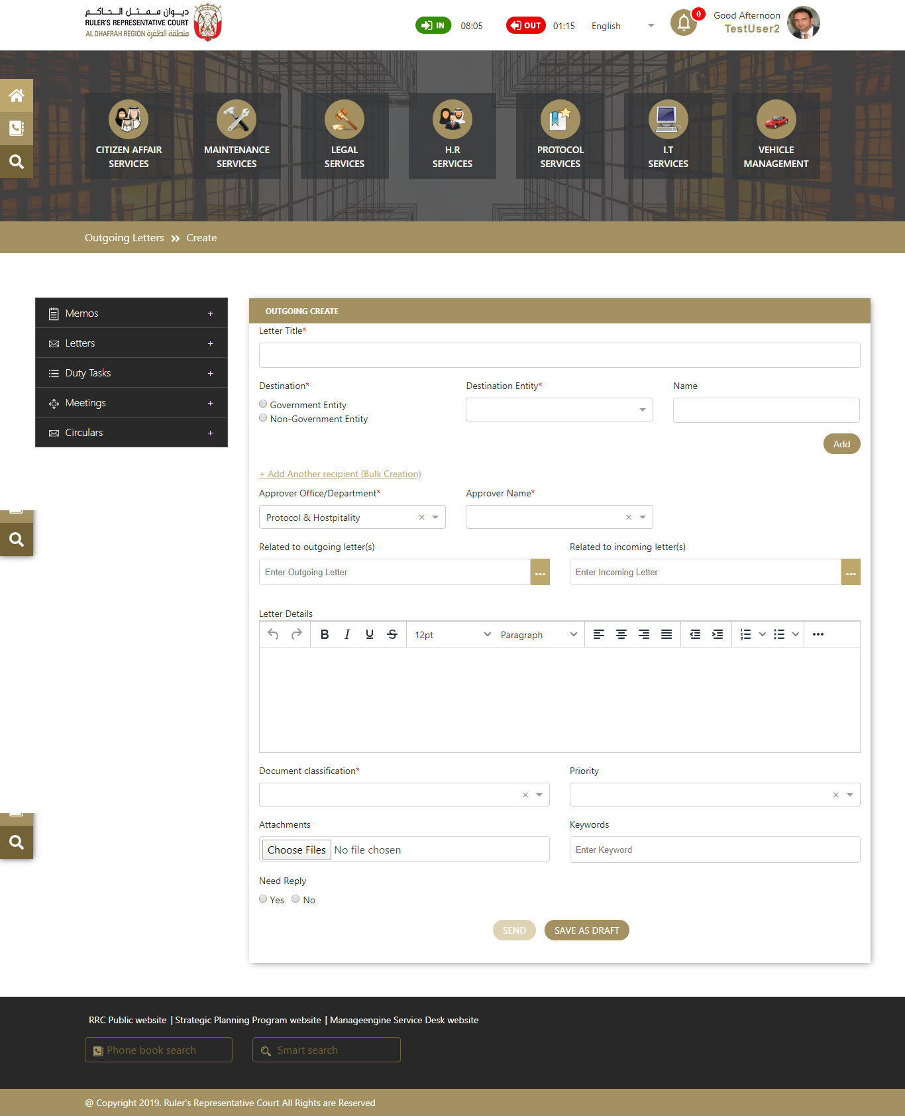
Letter creation Page

Slide 31
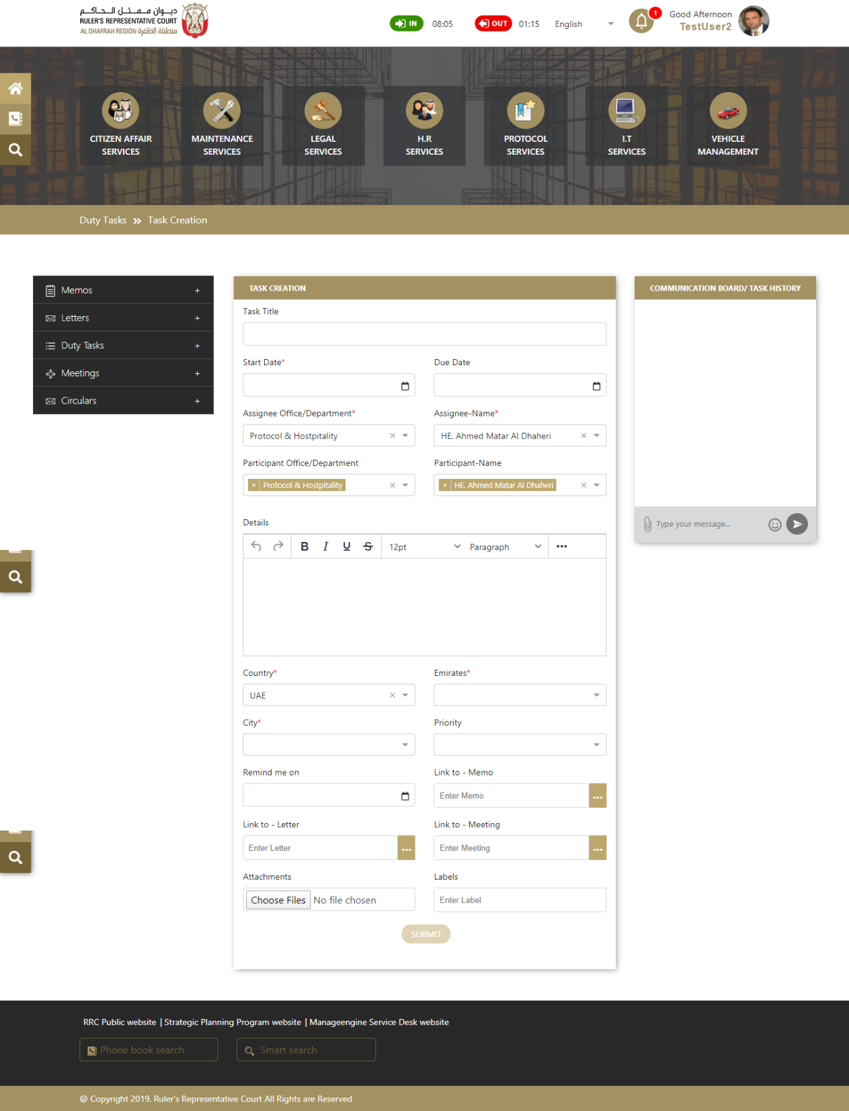
Duty Task Creation Page

Slide 32
PROJECT MANAGEMENT METHODOLOGY
Requirement Gathering
Verbat works with various stakeholders to identify User requirements.
Coding
Error free executable programs are created using the designs developed in previous steps
1
5
Feasibility Study Through POC’s Verbat will verify if it can meet the client requirements
Testing Implemented in all phases from req. gathering to coding. Over 50% of effort is used in testing.
2
6
System Analysis The team will analyze the project to determine Scope, Limitations, Resources and Schedules
Implementation Software is tested for portability and adaptability and integration issues are solved.
3
7
Software Design The requirements are translated to logical & physical designs accompanied by pseudocode
Operation and Maintenance Users are trained with sufficient documentation to operate the software correctly
4
8

Slide 33
HIGH LEVEL PROJECT PLAN
Initiation
Prototype, & Documentations
Prototype/UI/UX Approval
Development & QA
DB Design
Coding
Testing
QA
Deployment & Maintenance
UAT
Sign-off
Warranty /Support
Administrative tasks (Contract, Advance payment)
Project Kick-off
Other Documentation Deliverables
BRD/SRS creation and approval
Prototype/UI/UX Initiation
On Project Approval
96 days from Prototype/UI/UX Approval
After 20 days
After 14 Days Development

Slide 34

PROJECT MANAGER
PROJECT
TEAM
BUSINESS ANALYST TEAM
PROJECT COORDINATION TEAM
DELIVERY MANAGER
DESIGN TEAM
DEV TEAM
QA TEAM
TECH WRITER

Slide 35


ARCHITECTURE
DIAGRAMS

Slide 36
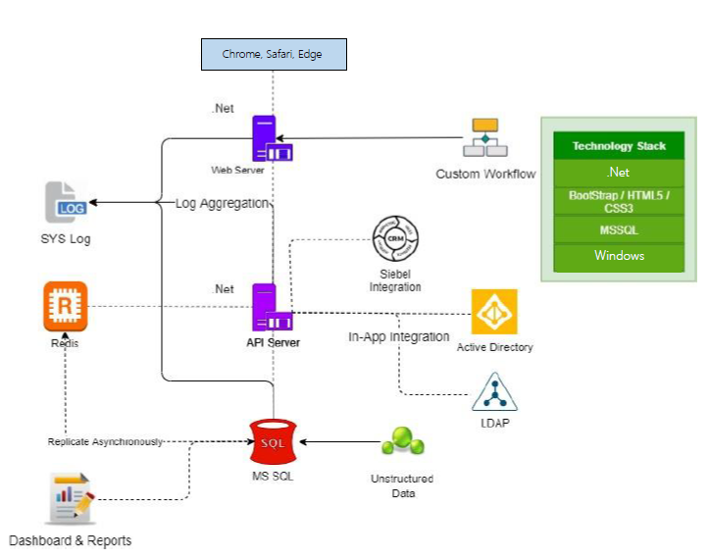
MINIMUM VIABLE ARCHITECTURE
Notes:
Detailed software and hardware requirements of the proposed solution and its scalability.
Solutions adaptability/configurability to the changing business requirements.

Slide 37
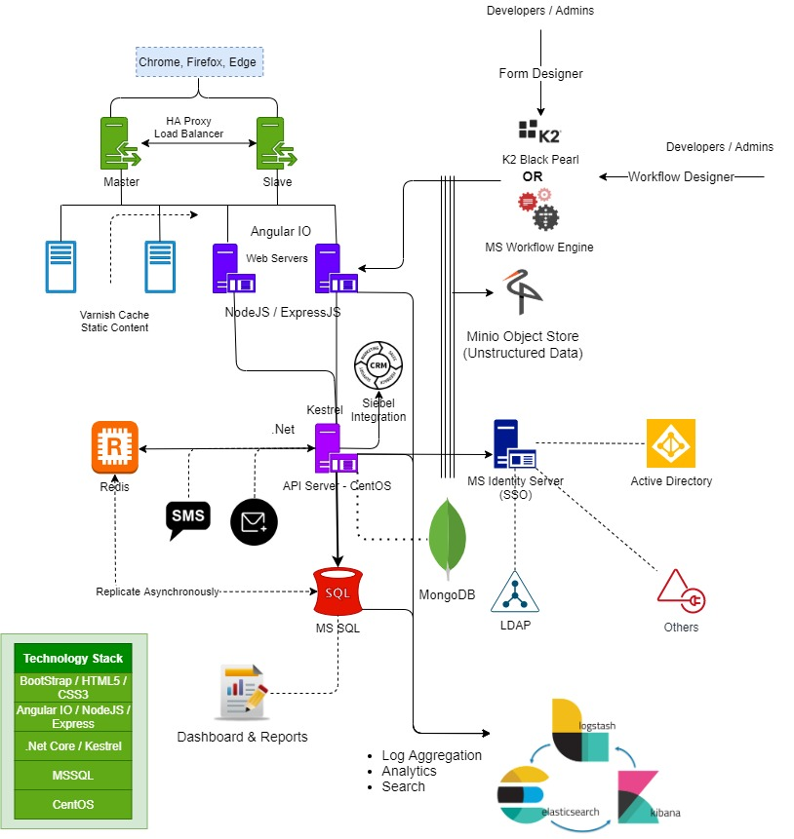
SCALABLE ARCHITECTURE
Notes:
Detailed software and hardware requirements of the proposed solution and its scalability.
Solutions adaptability/configurability to the changing business requirements.
Solution needs various kinds of reports as well as dashboards for management
ELK stack helps with this
Solution requires the storage of audio / video / images and referral material
MinIO
Fast access to frequently accessed data
Redis
Solution requires a loosely coupled architecture to accommodate future needs
API server with WSO2 as well message bus based decoupled services
Authentication using different credential providers
Identity server
Custom workflow development
K2 Black pearl or MS workflow engine

Slide 38
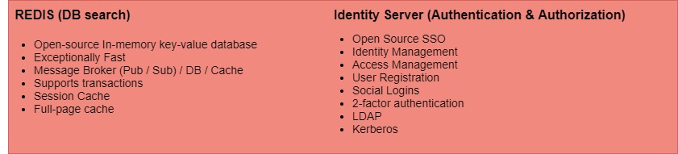
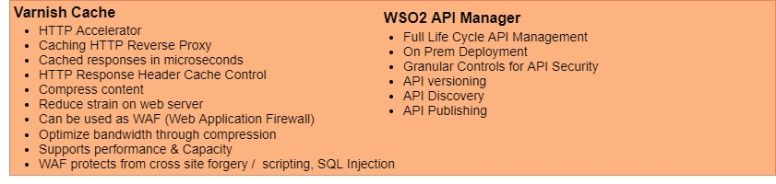
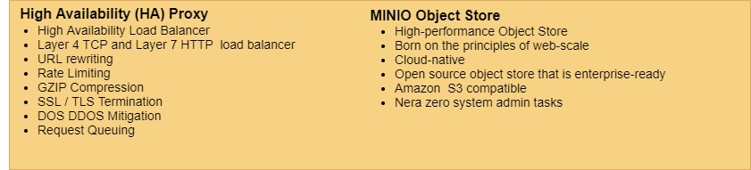
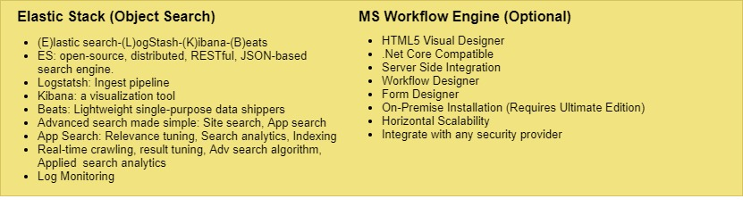
ARCHITECTURE
RATIONALE
Notes:
Detailed software and hardware requirements of the proposed solution and its scalability.
Solutions adaptability/configurability to the changing business requirements.

Slide 39
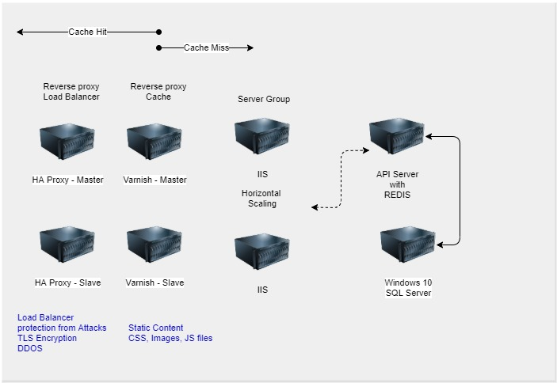
NETWORK
TOPOLOGY
Notes:
Detailed software and hardware requirements of the proposed solution and its scalability.
Solutions adaptability/configurability to the changing business requirements.

Slide 40
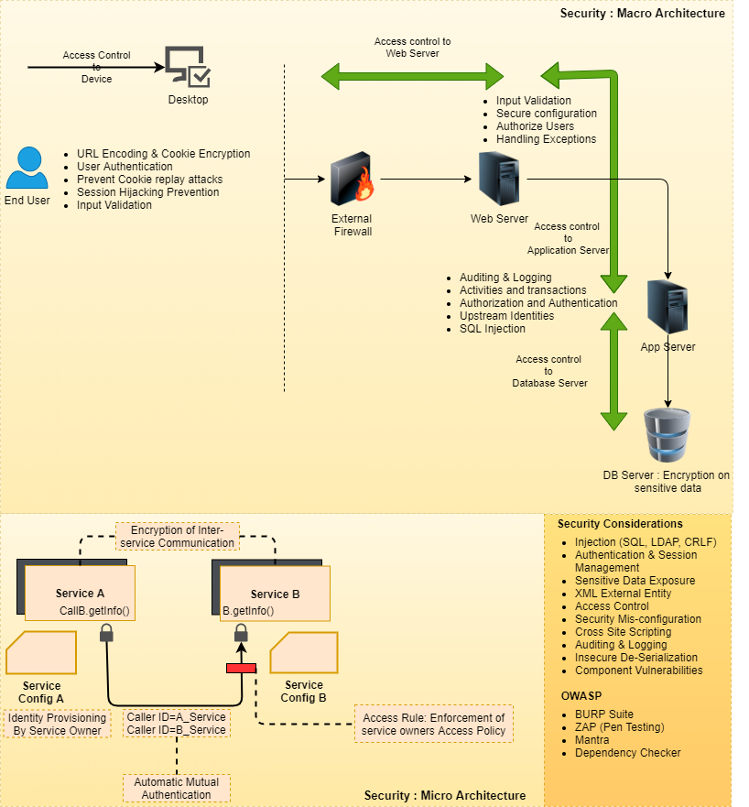
SECURITY
FRAMEWORK
Notes:
Detailed software and hardware requirements of the proposed solution and its scalability.
Solutions adaptability/configurability to the changing business requirements.

Slide 41
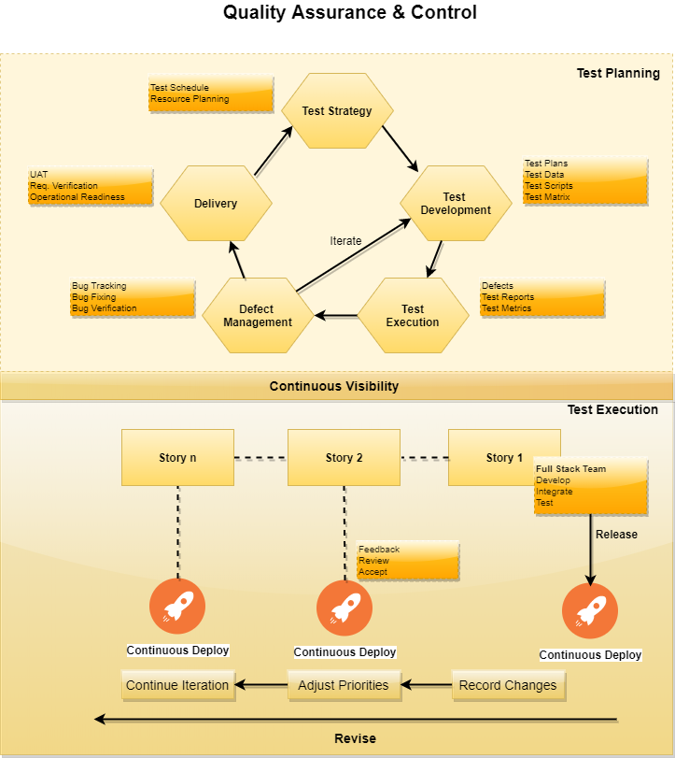
QUALITY
ASSURANCE
Notes:
Detailed software and hardware requirements of the proposed solution and its scalability.
Solutions adaptability/configurability to the changing business requirements.

Slide 42
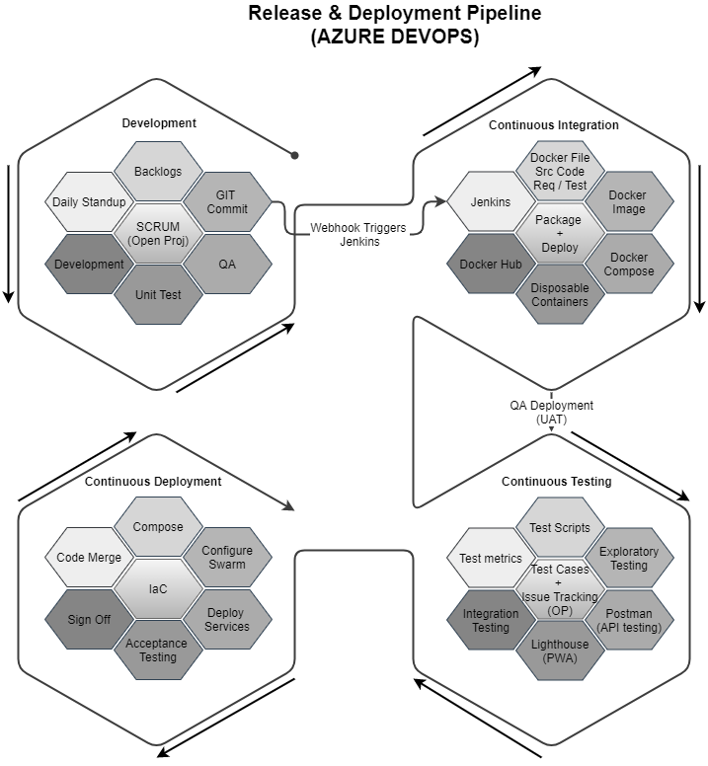
RELEASE &
DEPLOYMENT PROCESS
Notes:
Detailed software and hardware requirements of the proposed solution and its scalability.
Solutions adaptability/configurability to the changing business requirements.

Slide 43

[
[
Q A
&

Slide 44




At Verbat, we are committed to make IT services a pleasant experience. As such we always welcome your enquires, feedback and suggestions
Let’s Hear From You
Get in Touch
217, Sheikh Rashid Building PO Box 56272, Dubai
+971 4 2973236
USA 600 Eagle View Blvd, Suite 300
Exton Pa 19341
INDIA Level III, PTC Tower, Nanthancode, Trivandrum, Kerala
Luay.houri@verbat.com

Slide 45
A VERBAT
THANK YOU
PRESENTATION

Slide 46
